Slide 1
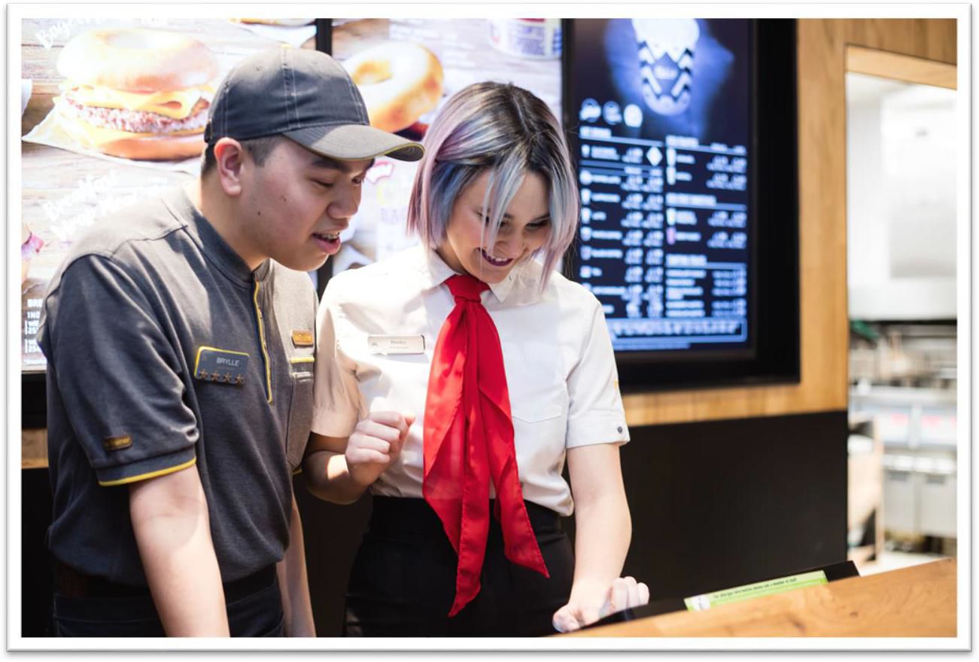
Case Study
Crofton Park Restaurant
Welcome to Crofton Park Restaurant
Congratulations! It’s Friday 9th April and earlier this week you were appointed Business Manager of the Crofton Park Restaurant.
You have been given an information pack about your restaurant. Read through all of the information contained within this pack and devise an action plan in the area of People, which will help to guide you and your restaurant team through the next 12 months.
Once you have created your action plan you will then need to present it as a team.

Slide 2
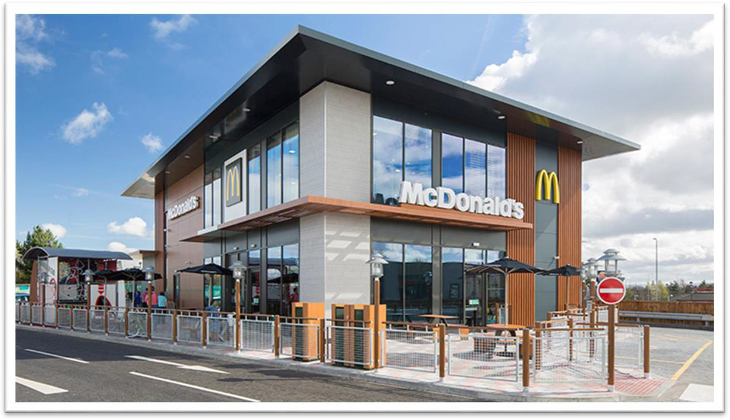
Restaurant Overview
General Overview -
Annual sales of 4.25 million
Drive thru restaurant with children’s play area and 200-seat dining area
Two story restaurant with a small crew room
Profit and loss (P&L) has improved 0.75% vs. last year, however it is currently off target by over1%
Sales have been strong, with a 2% increase vs. last year
People Overview –
112 working staff members
21 people have left so far this year
Staff turnover is currently 68%
Staff are averaging 55 hours per week
Current hiring status is RED, with a hiring need of 28 people in the next 6 weeks

Slide 3
Introduction
Crofton Park restaurant is located next to a large recreational park in a relatively small town that is currently experiencing dramatic growth. It has a diverse population of 150,000 people. The local council has just unveiledplans to open a large retail park in the next 6 months one mile away from the restaurant.
Most of Crofton Park McDonald’s customers come from the local technology company and related businesses in a small industrial park nearby. During the week, breakfast and lunch are very busy, but dinner is not. Teenagers come in periodically at night and can cause disruption.
For a long time Crofton Park McDonald’shas had no immediate competition in the area. There is a KFC in the other corner of the town near the secondary school, although, by all accounts, it has been struggling for some time. Burger King has now announced that it will soon break ground on a new restaurant virtually nextto yours, with plans to have a grand opening in conjunction with the grand opening of the new retail park.
Crofton Park’s customer satisfaction survey shows that your customers during the week eat at this McDonald’s for one reason - it’s easy and convenient. Workers from nearby visit the restaurant as its close and they don’t want to take a pack lunch and don’t have time for a sit down meal a ta waiter/waitress restaurant. Families who visit the restaurant come because it’s what their children want. According to the data none of your customers have shown an affiliation to the brand but neither do they dislike it.

Slide 4
People
The restaurant has a large management team with a mix of generations and experience. Three new shift leaders have been promoted in the last 2 months. Yet over the past six months there seemed to have been rising conflict in the restaurantbetween the management team. Also there have been a number of complaints to Human Resources about managers being unprofessional and in some instances rude and aggressivetowards restaurant staff.
Last night you held a crew meeting, however only 20 people turned up. Today you have asked a couple of employees why they did not attend and they told you that they do not attend as they feel as though their opinion doesn’t count. Some points brought up in the crew meeting are highlighted below:
Employee of the month was announced
Employees asked what the next promotion was and when it was being launched
You covered McDonald’s 5 values and vision– this was new news to the employees
Employees complained about not being grantedrequests throughMyschedule
Announcement made on the recent promotion of two crew trainers
People Figures
This year so far 21 people have left the restaurant team – most of them didn’t even resign, they just stopped showing up. It is not difficult to replenish the staff and applications to the restaurant are high. Current pay rates are:
Crew (under18) | Crew (over18) | Customer Care | Shift Manager
£8.00 | £9.75 | £9.75 | Starting at £11.50
One employee did leave a resignation letter which you can view here:

Slide 5
Employee ResignationLetter:
Dear Business Manager,
Please accept this as my formal resignation from my position as Staff Member.
I have been working here over the past year and I have not had formal training ever since I started. I feel that I can do lot more however, I have not been given opportunity.
I have worked in the kitchen since my first day. I wanted to learn till, I have mentioned this to couple of the managers but they all say the same thing ‘we are short of Crew today and you are really good in the kitchen'. Most shift’s I end up working 12 hours with a 30 min break.
When I started I applied for part time position and was given one set of uniform however, three months ago I started to work full time but was told there was no budget for uniform therefore I had to make do with the one that I have until new uniforms gets ordered. I made some good friends in your restaurant and the location is very good as I can walk to work. But I can no longer continue to work due to above reasons.
I hope you canacceptmyresignation. Yours Sincerely,
Ash Dell

Slide 6
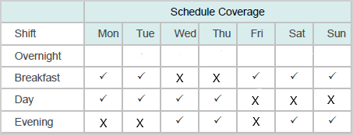
Below is the weekly people status report for Crofton Park restaurant. It shows that the restaurant needs more staff to ensure all day parts are sufficiently staffed with enough people to provide a great customer experience.
The report has also calculated how many staff you should have working in the restaurant to comfortably manage the sales you are projected to do over the next four weeks.
Based on the current rate at which staff are leaving Crofton Park restaurant, the report has projected a large amount of leavers.
Total Employees: the number of staff that are on the payroll for Crofton Park restaurant
Working Employees: the number of staff that have worked a shift in the last two weeks
Avg Excess NCT: it is expected that some staff will not work a shift for over two weeks (holidays, sickness etc.). Excess No Clocked Time shows how many staff in Crofton Park are not working shifts above what the company would reasonably expect. Excess NCT staff could indicate that staff are deliberately avoiding coming to work.

Slide 7
People Survey
Recently, the employees in your restaurant completed an employee feedback survey – the results showed some clear areas of opportunity for you and your management team to address.
Employees were asked to vote ‘agree’ or ‘disagree’ on a set of questions. Questions that were mostly voted ‘disagree’ by employees have been highlighted as areas of opportunity for the restaurant. The three main areas of opportunity as highlighted by restaurant employees are:
This McDonald's has a good work environment.
Crew in this restaurant work together asa team.
Managers in this restaurant treat mefairly and equally.
Overall, the team at Crofton Park restaurant gave an employee satisfaction rating of 36%. This falls significantly short of the company average, which is 85%. You have planned a meeting in with both your managers and crew to further understand why this survey is so low and how as a team you can improve in this area.
As part of the survey, crew were given an opportunity to submit their comments about the restaurant. A selection of these comments are below:
I’m sick of working on shifts where there aren’t enough staff to serve all of the customers, it’s stressful and I end up getting shouted at, even though I’m tryingmy best!
The managers are always stressed and they take their frustration out on us!
I love working at Crofton Park restaurant, I have great friends here but I wish I knew more about the business or had the opportunity to contribute my thoughts and suggestions.
I think we all try really hard in Crofton Park McDonald’s, but we don’t always work well as a team. We need an opportunity to get to know each other away from the stress of thecustomers.

Slide 8
People
On Monday you completed a store walk and took some notes on different areas of the restaurant. Below are the notes you took whilst in the crew room:
Photographs up on one wall from Crew night out last year
Crew room has a computer, TV, table with 8 seats and a wall of lockers
2 seats ripped
Cleanliness of the crew room was poor
Whilst conducting the counter and kitchen store walk you overhear 2 crew members talking about managers having favourites. You also notice that the majority of females work the service areas whilst most of the males work the kitchen and backup areas, this includes the management.
Upon finishing the store walk on the Dining Area you made the following notes:
Good level ofcleanliness
Large digital noticeboard
New tables and chairs
2 crew members having their lunch together at a table

Slide 9
Creating a Plan
Now you and your team have read through all of the information about your new restaurant, it’s time to create a plan in the area of People.
Working together in your team, develop an action plan with clear goals and actions. When setting goals, consider the order you would complete them based on priority – remember goals need to be Specific, Important and Measurable (SIMple).
When planning, be sure to put aside time to consider how you will present your action plan, ensuring that everyone in your team has a chance to present. We would like to hear how you arrived at your decisions as a team. We will ask questions about your presentation, so be prepared!
You now have 30 mins as a team to create a plan and be ready to present back.

Slide 10
Our McDonald’sValues
Our McDonald’s values show what matters most to us and they tell the world what McDonald’s stands for. In 2020 the values were refreshed to make them clear, concise and reflect the world we live in. This way everyone in our McFamily can clearly understand what our values are and how they can live by them.
Serve
We want to make every interaction at McDonald’s special whether you are a customer or part of the McFamily. Your safety and wellbeing is our top priority.
Inclusion
Inclusion is about coming to work and being yourself. It is about knowing everyone has the same opportunities. We want all our people to feel as though they belong to McDonald’s.
Integrity
At McDonald’s we do the right things by our people and society. It’s our priority to keep you and our customers safe.
Community
Our McFamily is huge and we have a responsibility to give back to the communities we work in. We want our customers to feel good about our food, our company and the impact we have on their community.
Family
At McDonald’s wework better together. Our McFamily isall about working with everyone involved in running a restaurant from our crew to all of our suppliers.

